Slide 1

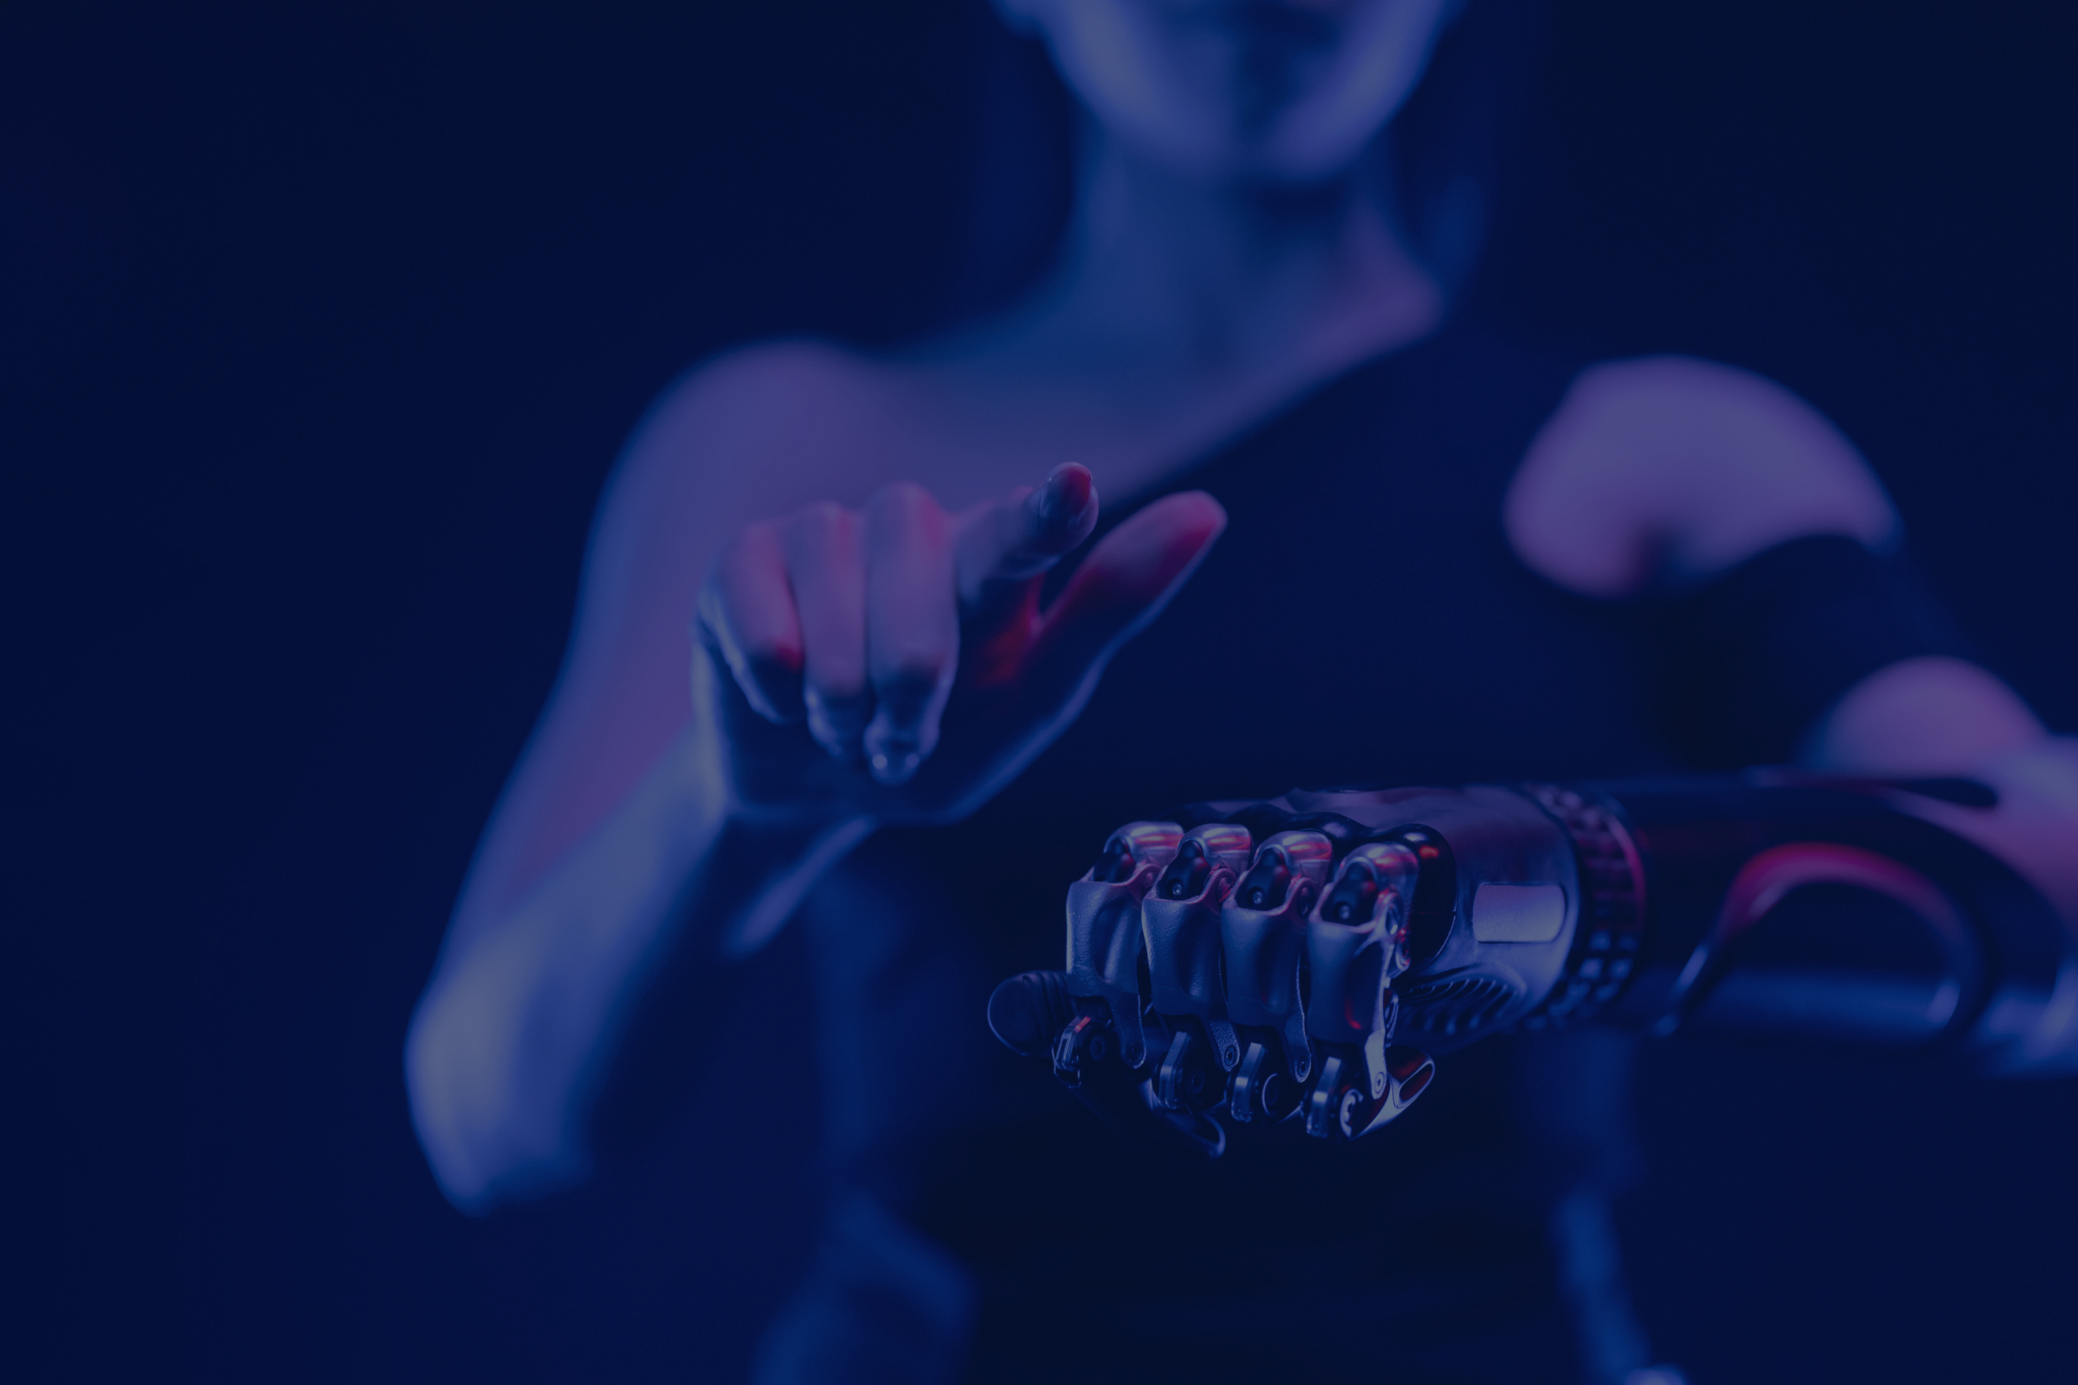

hack2hire2024
Artificial Intelligence
This presentation will introduce State-of-the-Art QA Model with Quora Dataset , highlighting its objectives, methodologies, and potential impact.
Submission by: Zareen Khan

Slide 2
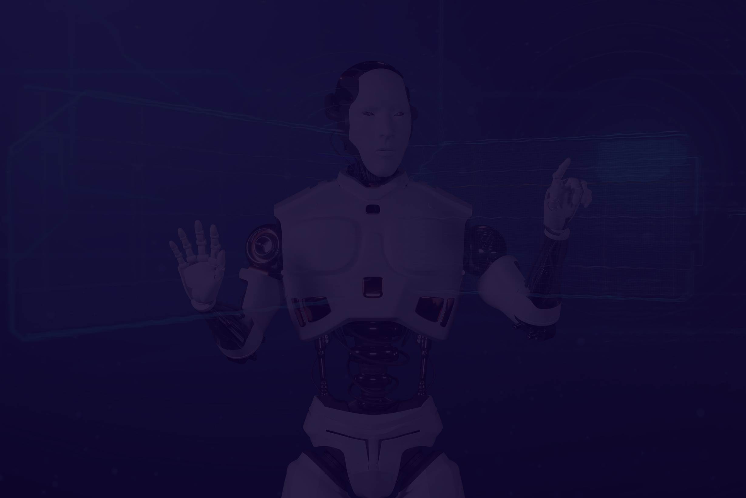
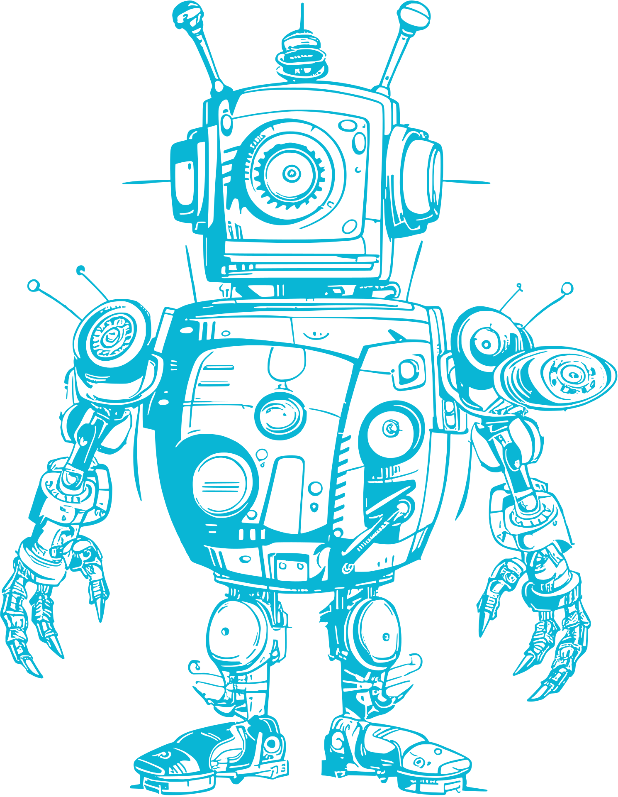
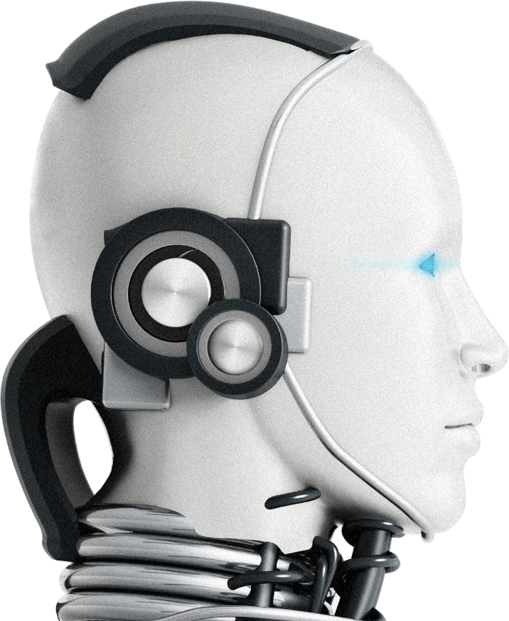
02
Model Overview
The chatbot developed as a solution to the problem leverages state-of-the-art NLP models to deliver high-quality, human-like interactions. By utilizing advanced preprocessing techniques, training sophisticated models, and integrating them into a user-friendly interface, we have created a chatbot capable of providing accurate and contextually relevant responses to user queries.

Slide 3


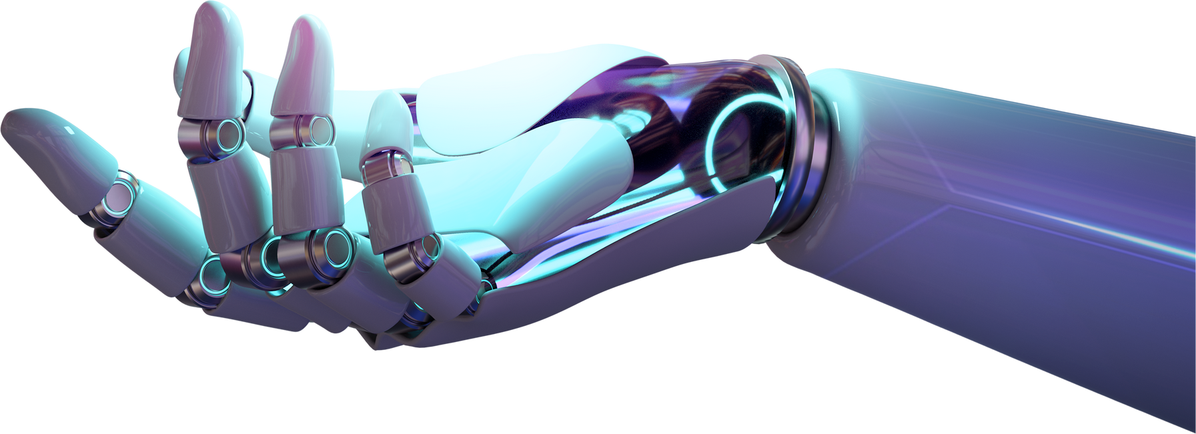
Problem Statement
To develop a state-of-the-art question-answering model leveraging the Quora Question Answer Dataset. The objective is to create an AI system capable of understanding and generating accurate responses to a variety of user queries, mimicking a human-like interaction.
03

Slide 4




04
Methodology
Data Collection
Preprocessing
Model Selection
Gather relevant data from diverse sources.
Clean, normalize, and engineer data.
Choose and train ML/DL algorithms for peak performance.

Slide 5

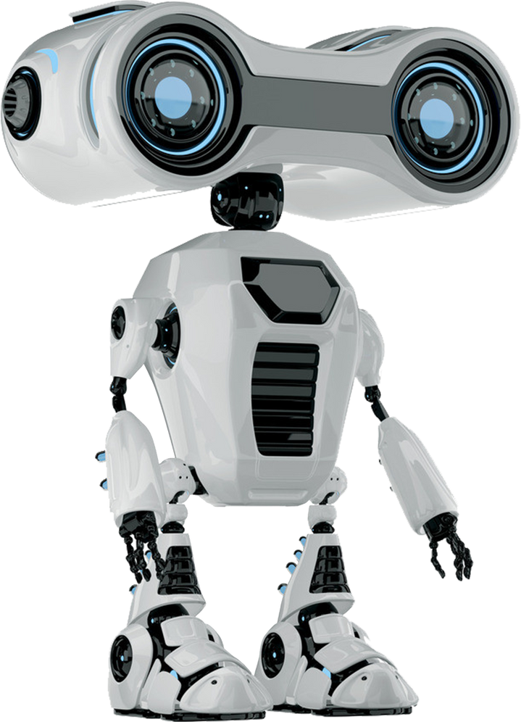
05
Data Collection and Preprocessing
We gather the dataset from and clean, normalize, and preprocess the data to ensure its quality and consistency. This step is crucial for training accurate and reliable AI models like BERT ,T5, GPT.

Slide 6

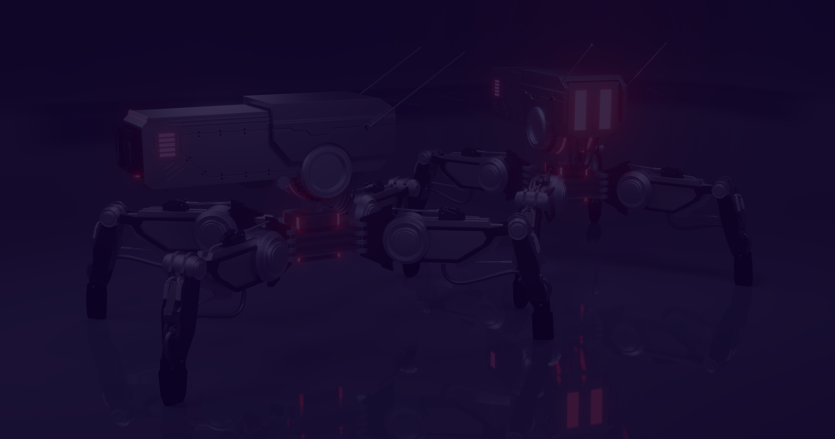

06
Model
Development
We design and implement machine learning and deep learning models tailored to the specific requirements of the project.
BERT will be considered the best choice. Its bidirectional nature allows it to capture the nuances of the question and potential answers more effectively.
GPT: Excels at generating text, making it suitable for tasks like summarization, translation, and creative writing.
Can be adapted for question answering but might not perform as well as BERT due to its unidirectional nature.
T5: Highly versatile, capable of handling various NLP tasks.
Can be a strong contender for question answering, but might require more fine-tuning compared to BERT

Slide 7



Evaluation Metrics
07
We define appropriate metrics to assess the performance of our AI models, such as metrics like ROUGE, BLEU, and F1-score to assess model performance. These metrics help us quantify the effectiveness of our solutions.
By calculating these metrics for the BERT model's generated answers compared to the ground truth answers in the Quora dataset, we can obtain a quantitative assessment of the model's performance.
High ROUGE and BLEU scores indicate that the model is generating answers that closely match the reference answers in terms of word overlap and n-gram similarity.
High F1-score suggests that the model is effectively balancing precision (correct answers) and recall (covering a broad range of correct answers).

Slide 8

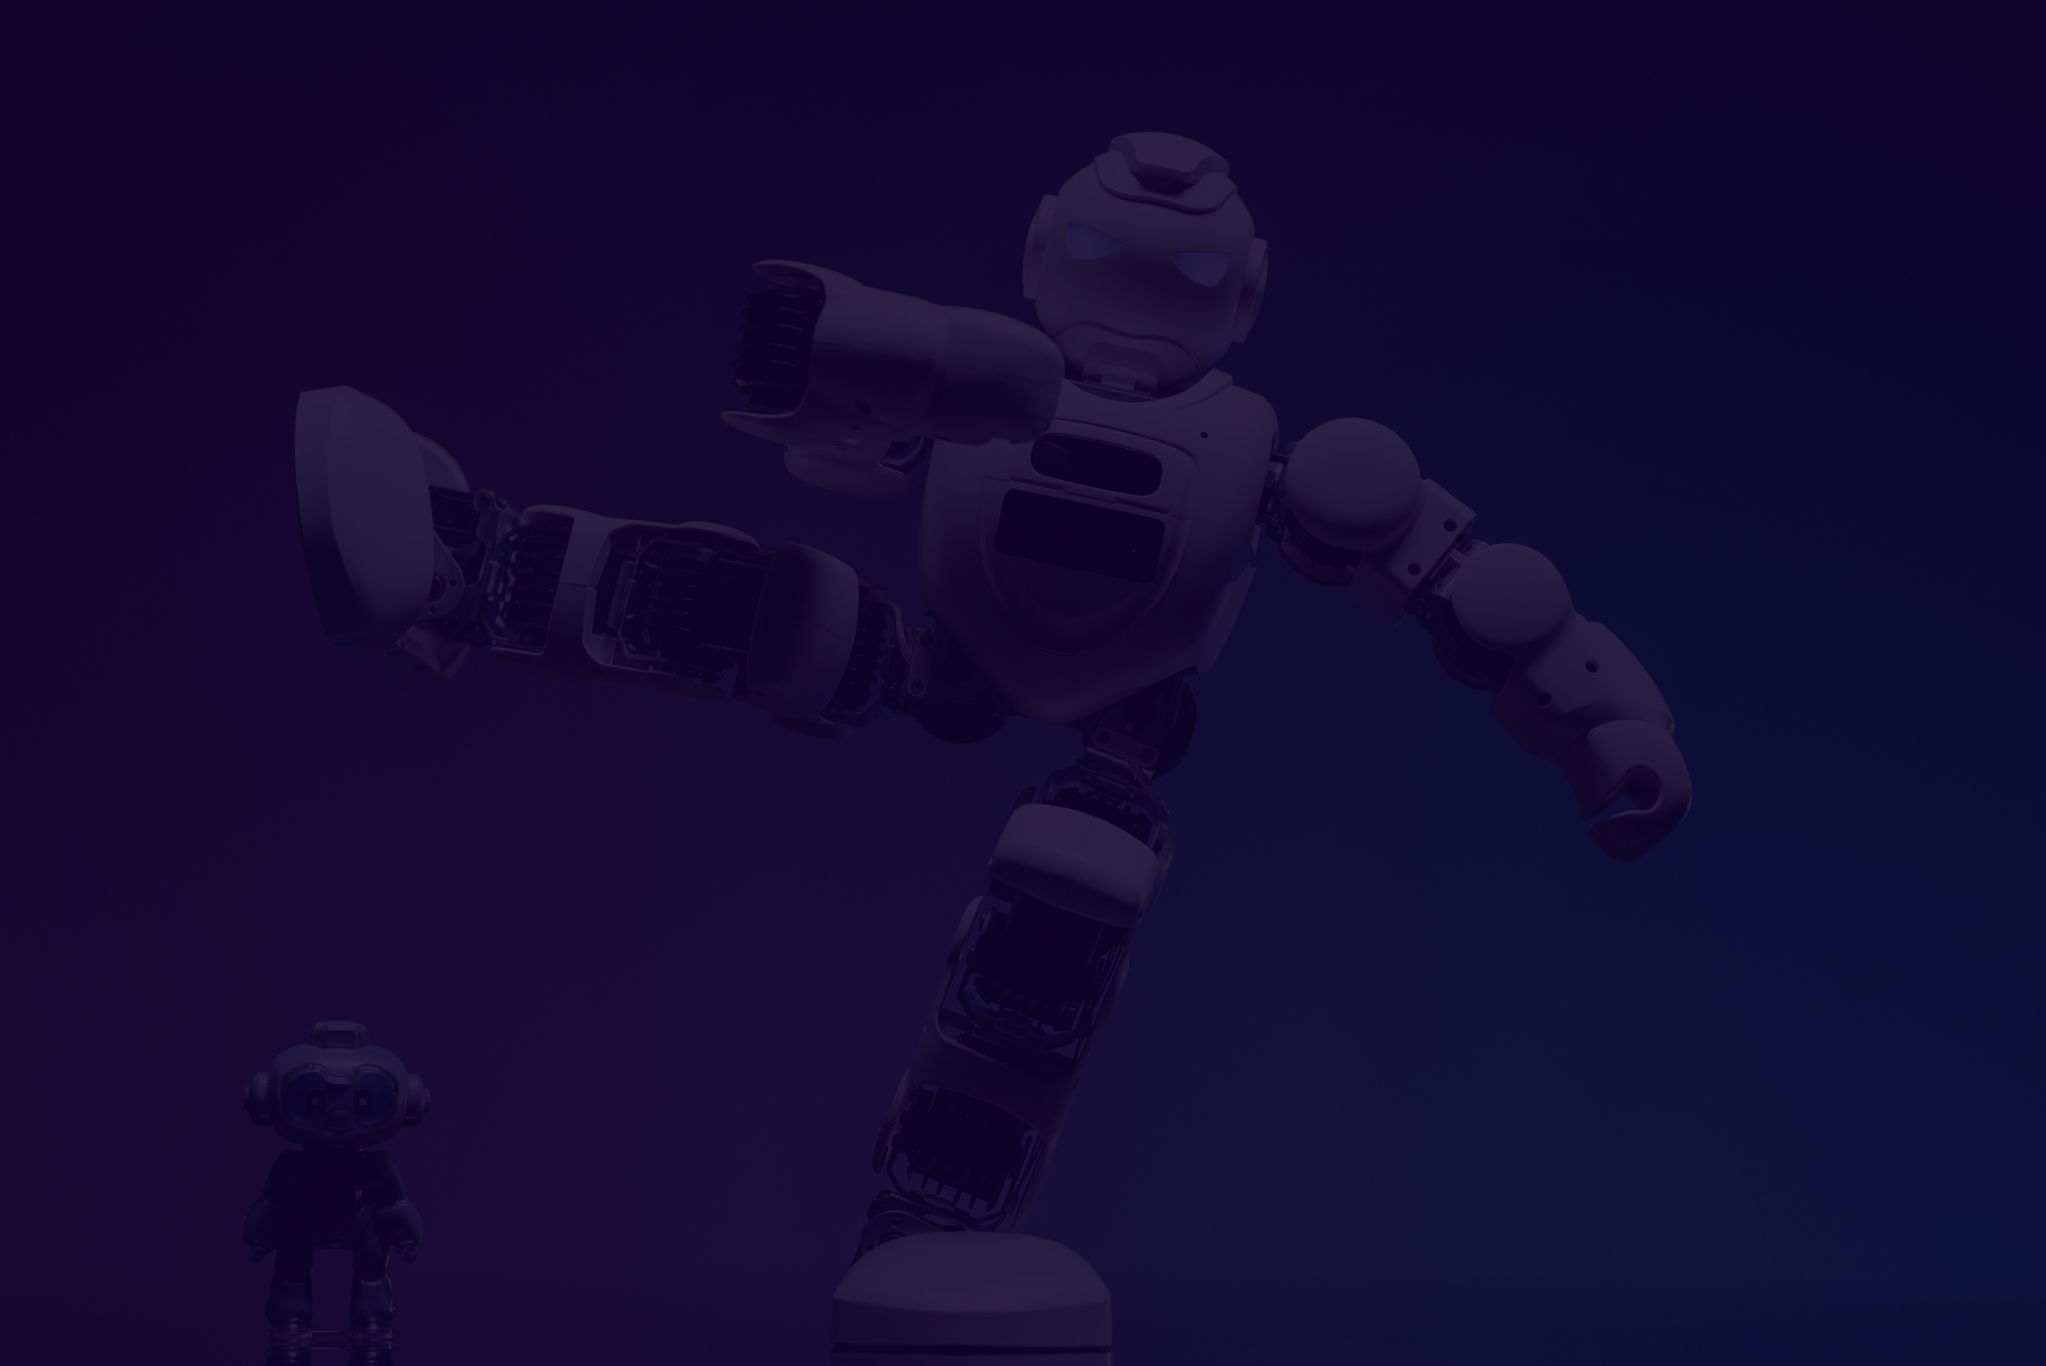
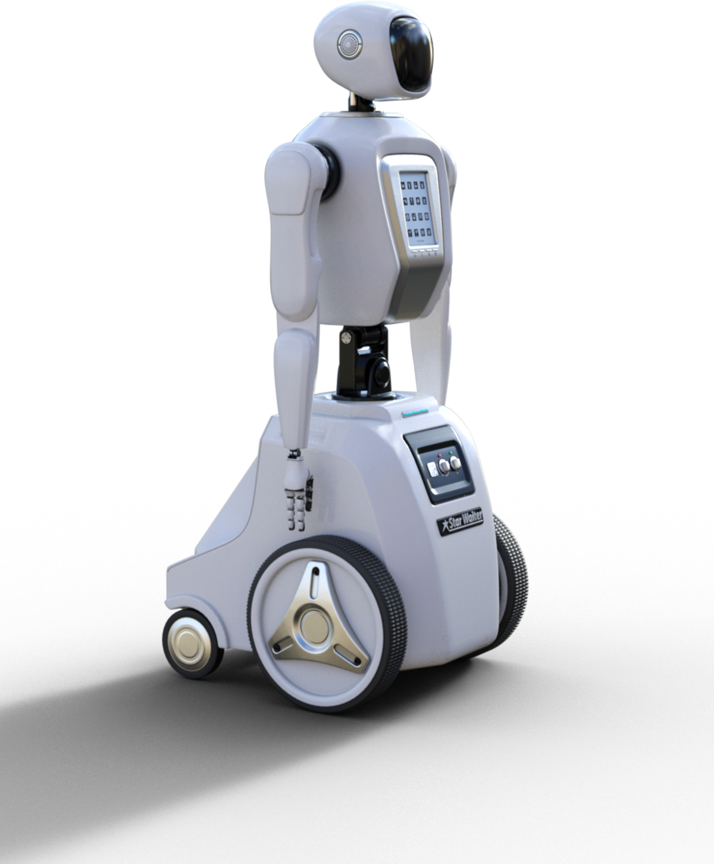
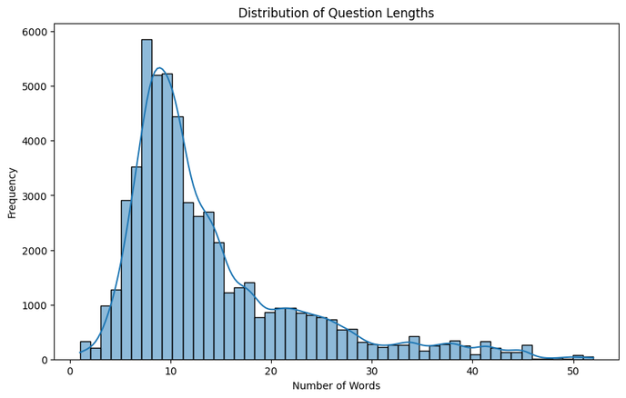
Result and Impact
Based on a heuristic analysis that considers whether the answer contains numbers or letters only, approximately 33% of the questions are factual, while 67% are open ended. This is a rough estimate, and more sophisticated techniques can be employed for more accurate classification.
The average answer length is 89.75 characters, with a standard deviation of 93.38 characters. The shortest answer is 5 characters long, and the longest answer is 200 characters long.
08

Slide 9

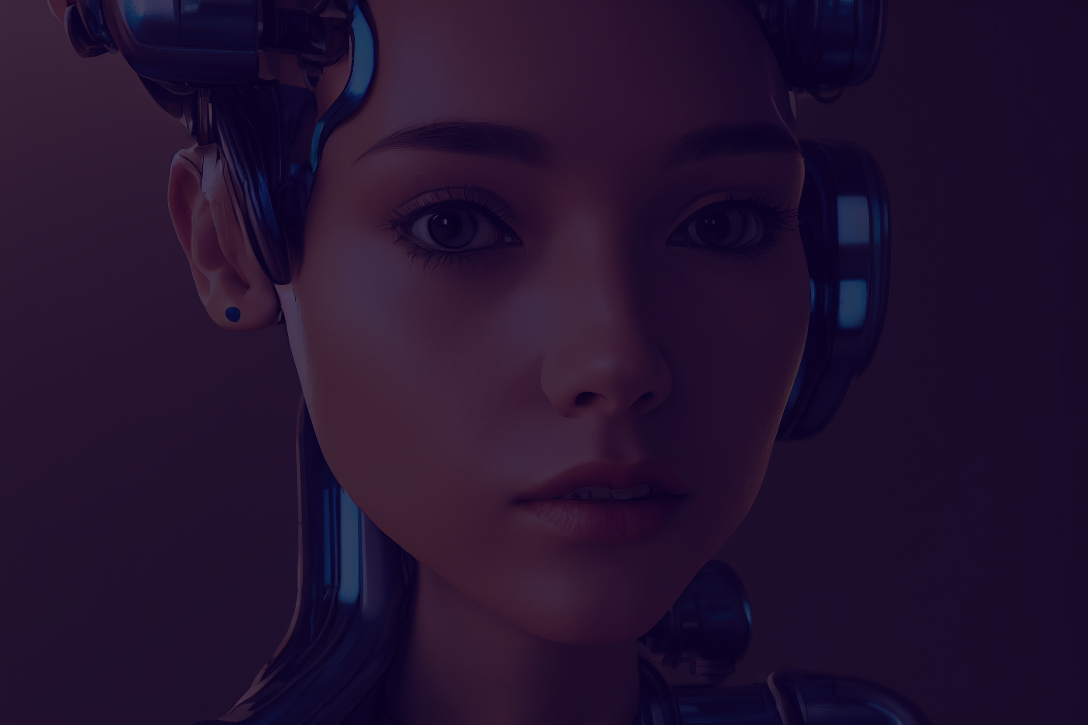
Notable Suggestions
Reinforcement Learning from Human Feedback (RLHF)
User preferences and feedback can significantly improve model performance.
Improvement: Train the model to align with human preferences using RLHF.

Slide 10




Thank You!
Github Link :
https://github.com/zareenatGitHub/Hack-2-Hire-data-science
zareenkhan2885@gmail.com

